Slide 1
An Introduction to
OCLC WorldShare® Interlibrary Loan
Michael Cosentino
Senior Training Coordinator
OCLC
August 2013

Slide 2
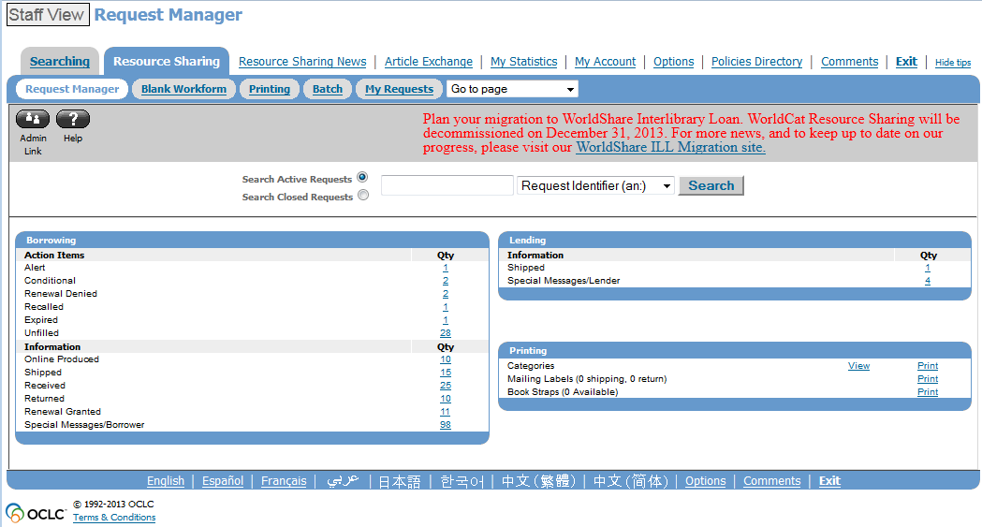
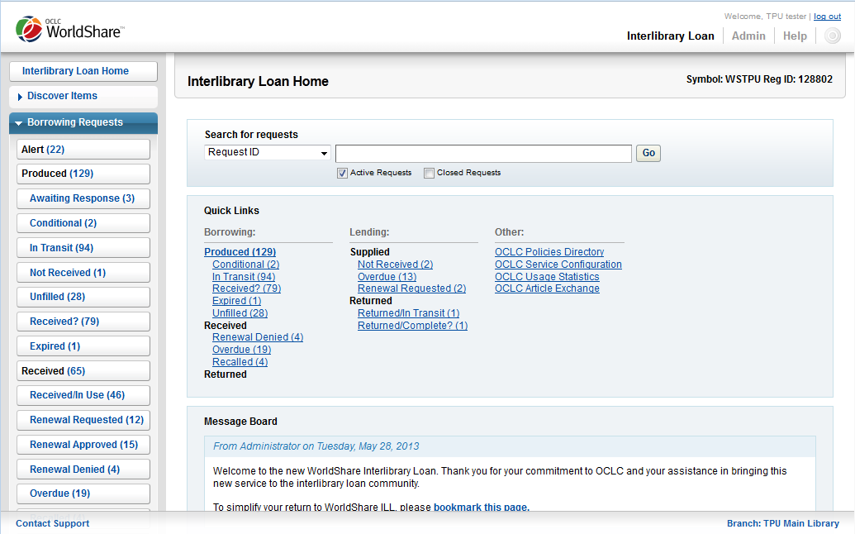
Migration: WorldCat Resource Sharing WorldShare® ILL
WorldShare ILL
WorldCat Resource Sharing
Notes:
WorldCat Resource Sharing debuted in 2005. WorldShare ILL launched in 2012 with completion of migration planned by December 2013.
WorldShare ILL is the updated version of OCLC’s ILL service. It is built on a new software platform- so the interface will look new and different. But this new platform also means OCLC can continue to enhance and improve the service with new features and functionality- something we could not do on the current ILL service, WorldCat Resource Sharing.

Slide 3


Timeline
November 2013:
End of new requests in
WorldCat Resource Sharing
March-December 2013: Open migration to WorldShare® Interlibrary Loan (in U.S.)
2013
June-September 2013: Non-U.S. WorldCat Resource Sharing subscribers migrate to WorldShare® Interlibrary Loan
January 3, 2014:End of
access to WorldCat
Resource Sharing

Slide 4
Special Users
What if I use ILLiad?
  WSILL is optional- set up new User Name & Password, and acquire custom Web address to check OCLC requests natively
  The next version of ILLiad (8.4) will start to incorporate new features. http://www.oclc.org/en-US/illiad/latest-version.html
What if I use Clio?
  Older versions of Clio will stop working with OCLC 30 June 2013.
  Use Clio version 6.7.1 or higher by the end of June 2013.
Notes:
What if I use ILLiad
ILLiad users do not have to use the WSILL service unless they want to.
The next version of ILLiad (8.4) will start to incorporate new WorldShare ILL features.
If ILLiad users want to view WorldShare ILL they can set up an account starting this summer.
What if I use Clio?
OCLC will be switching off older versions of the web services that connect Clio to OCLC on 30 June 2013
Libraries should be running at least Clio version 6.0 by the end of June 2013

Slide 5
Special Users
What if I subscribe to OCLC through a state group?
  We are talking with your group administrators to arrange training for the group.
  You may migrate on your own if you wish.
What if I work on behalf of others?
  If you place requests on behalf of other libraries don’t migrate until the second half of 2013.
  Be sure to contact Christa for more information.
    Christa Starck starckc@oclc.org
Notes:
What if I subscribe to OCLC through a group?
We are talking with your group administrators to arrange training for the group
You may migrate on your own if you wish
What if I work on behalf of others?
Those who use WCRS to place requests on behalf of other libraries should not migrate until the second half of 2013
If you work this way, and have not been involved in any conversations with OCLC to date
please contact Christa Starck starckc@oclc.org

Slide 6
What can I do to prepare? http://www.oclc.org/migrate-worldshare-ill/preparation.htm

Slide 7
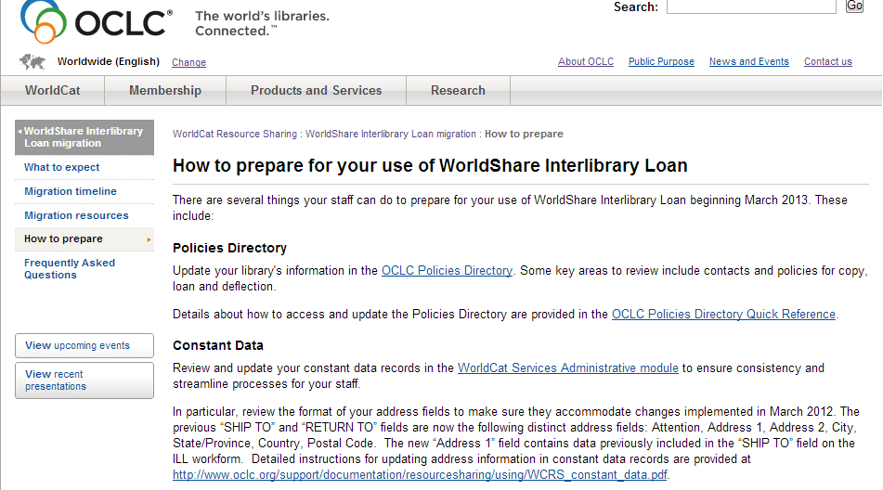
OCLC WorldShare Interlibrary Loan migration website
http://www.oclc.org/migrate-worldshare-ill/preparation.htm

Slide 8
The good, the bad, and the ugly about
Constant data
All OCLC ILL libraries must modify their constant data records for all Shipping fields for the launch of WorldShare® ILL.
Failure to do so will result in WorldShare® ILL libraries having major issues with address labels.
Numbers must be used when using number fields!

Slide 9
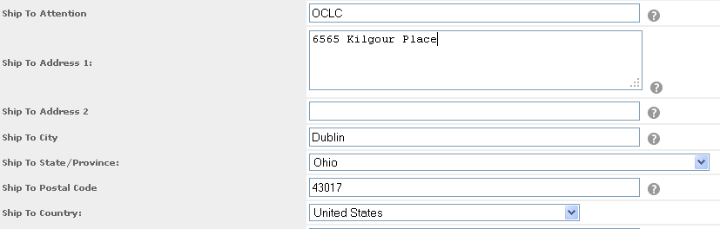

The Good

Slide 10
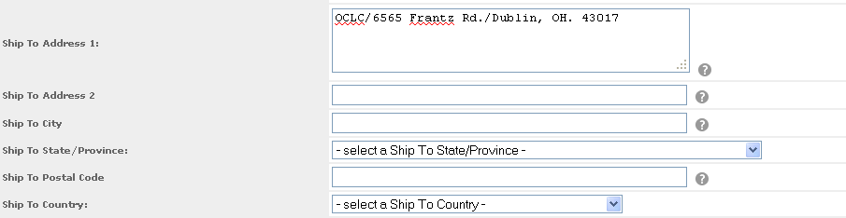

The Bad

Slide 11

The UGLY
Address labels will print like this:
OCLC/6565 Kilgour Place/Dublin, OH. 43017
Not like this:
OCLC
6565 Kilgour Place
Dublin, OH 43017

Slide 12
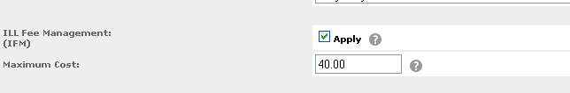





Numbers numbers numbers
Numbers must be used when using number fields!

Slide 13


Recommended Browsers
IE9
IE8
IE7 – Not supported
Chrome
v27.0.1453.94 m (recommended)
Firefox
v21.0
(preferred)
If you are not sure what browser or version you are using, go to http://thismachine.info
Notes:
When using WorldShare ILL, it is recommended you use one of the Web browsers we have listed on the screen- Mozilla Firefox, Google Chrome, and either version 8 or 9 of Windows Internet Explorer. (Supported versions are Chrome 27.0.1453.94 m; Firefox 21.0; IE 8 & IE 9).
These browsers are recommended because “WorldShare ILL has been developed to function best when used with specific browsers that provide the infrastructure and technology required to support the state-of-the-art functionality included in the service.”
If you’re not sure what browser you’re using at your library, the link we have on the screen can help you figure it out.
We’ll post this link in the chat window, and if you click on it from the chat window, it will tell you which browser you’re using and which version of it.
Paste this link into chat window: http://www.thismachine.info/
Notes for trainer only:
Ask the audience for any questions, but try not to linger on this point too long. If a library has an earlier version of IE, ask if they can install Chrome or Firefox. If a library absolutely cannot use any of these browsers, they will not be able to use WorldShare ILL. Refer folks to OCLC Customer Support as needed.
Paste FAQ page url into chat window - http://oc.lc/uWxTGU or http://www.oclc.org/en-US/migrate-worldshare-ill/questions.html
[CLICK TO NEXT SLIDE]
~0:70

Slide 14
Training classes
Borrowing
Lending
Deflection
Custom Holdings
Searching and
submitting loan and copy requests
Managing requests
as a borrower
Printing requests
Managing requests
as a lender
Printing requests
Category-level deflections in Policies Directory
Item-level deflections in Connexion Browser
Create Groups and Paths of your preferred lenders
Apply them to borrowing requests
All will be available as both live webinar and self-paced

Slide 15
Training classes
Special training webinars just for New York libraries:
Otherwise, see full online training schedule for all member libraries here:
http://www.oclc.org/support/training/portfolios/resource-sharing/worldshare-ill.en.html
WorldShare® ILL Borrowing
Monday, Aug 19th
2pm-4pm ET
Registration required
WorldShare® ILL Lending
Tuesday, Aug 20th
2pm- 4pm ET
Registration required

Slide 16
WorldShare® ILL is a replacement for WorldCat Resource Sharing.
There is no change in subscription prices.

Slide 17
Feature roadmap:
Current WCRS features in WorldShare® ILL
Request history
Barcode printing
KnowledgeBase links (for lender)
Improved batch processing workflow
Improved print workflow
Batch printing of shipping labels and book straps
Batch processing for YES (Shipped)
March

Slide 18
Feature roadmap:
Current WCRS features in WorldShare® ILL
Conditional notes
Links to borrowing and lending library’s OPACs
Batch processing for NO
Automatically applying constant data to a request
Printing all requests in a queue
Knowledge Base links (for borrower)
French and Japanese translations
Patron workform with new Discovery interface
May

Slide 19
Feature roadmap:
NEW features in WorldShare® ILL
March
Lender string expanded to 15
Improved Workflow for printing and batch processing
May

Slide 20
Feature roadmap:
NEW features in WorldShare® ILL
August
Spanish interface
Initial buy-it workflow
Improved constant data functionality
Expanded request display
Full list of future functionality available here:
http://www.oclc.org/en-US/worldshare-ill/features/future-functionality.html

Slide 21
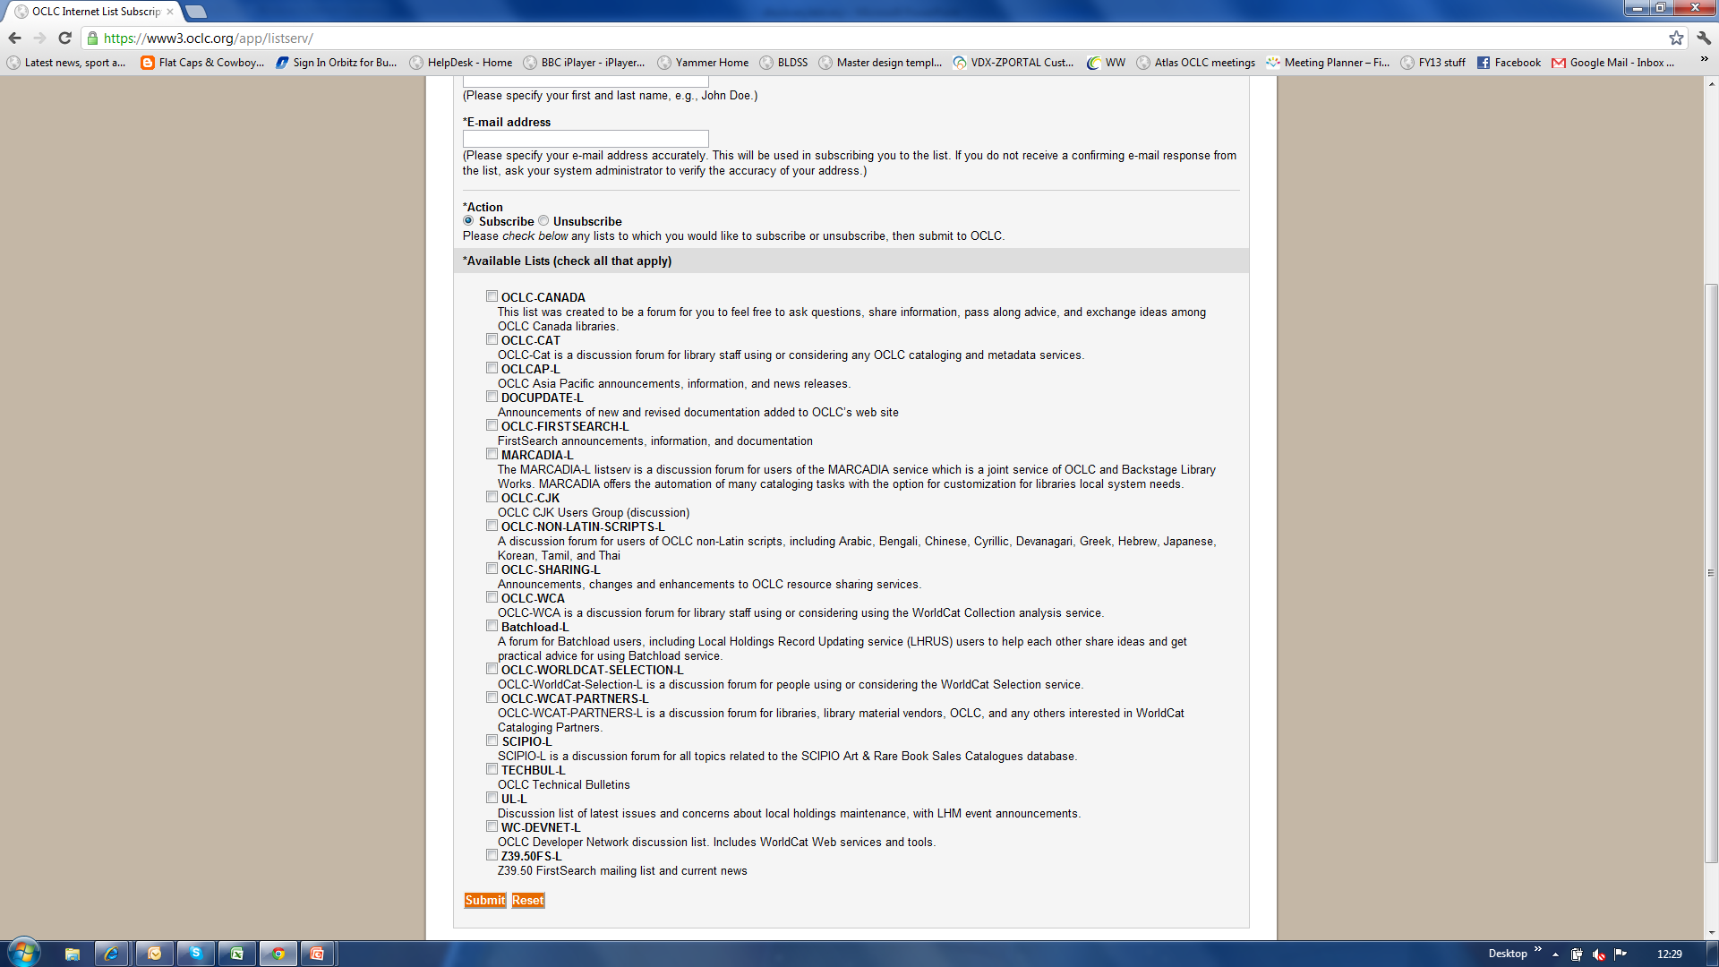
Keep up to date
Discovery OCLC-FIRSTSEARCH-L
Delivery OCLC-SHARING-L
https://www3.oclc.org/app/listserv/

Slide 22
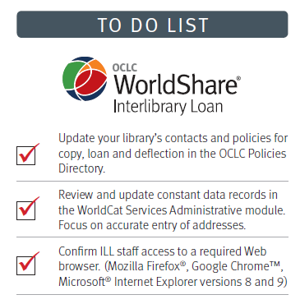
Preparation “To Do” List
  Stay informed, key web resources
  Update library’s contacts and policies in the OCLC Policies Directory
  Review and update constant data records
  Verify browser configuration
  Create accounts
  Review training and documentation resources

Slide 23
Setting up New Accounts
Notes:
See “Setup and management of OCLC Services accounts for access to WorldShare® Interlibrary Loan” presentation.

Slide 24
Additional Info

Slide 25

WorldShare® ILL Migration
If migrating for WorldCat Resource Sharing:
  Compare WCRS and WorldShare® ILL features - http://oc.lc/zGzCvB
  All current requests waiting for you in WorldShare®; so will Constant Data, Custom Holdings, etc.
  Must switch to WorldShare® by January 3, 2014; can switch back and forth between two systems until then
Notes:
A quick note to anyone migrating from the current service, WorldCat Resource Sharing:
[CLICK]
WorldShare has most of the features and functionality you’re used to in the current system- IFM, lender string, etc; You can compare the features in WorldCat Resource Sharing vs WorldShare ILL at the shortened URL link - http://oc.lc/zGzCvB. Note, this document is included on the WorldShare ILL documentation page linked from the Training page.
Paste the documentation page URL into the chat window - http://www.oclc.org/support/training/portfolios/resource-sharing/worldshare-ill/doc-reference.en.html
[CLICK]
All of the requests you have active in the current system will there and waiting for you when you log in to WorldShare ILL- so will your Custom Holdings Groups, your Constant Data, etc.;
[CLICK]
and you must switch over to WorldShare ILL by the end of 2013. The ability to submit new requests in the current system goes away in November 2013. And though you can switch back and forth between new and old systems, we encourage you to use WorldShare ILL exclusively once you gain access to it.
Ask if anyone has any questions.
~1:00

Slide 26



Helpful Info- WorldShare ILL & associated modules
In WorldShare ILL, there are 3 main modules:
WorldShare® ILL
Custom Web Address!!!
OCLC Service Configuration http://worldcat.org/config/
ILL Policies Directory- http://illpolicies.oclc.org/
Notes:
Ok- let’s talk about some other things you’ll need to know about WorldShare ILL.
There are three main modules used with the service:
WorldShare ILL itself,
Something called OCLC Service Configuration,
And the ILL Policies Directory. Let’s talk about each in a little more detail:

Slide 27
Helpful Info- WorldShare ILL & associated modules
WorldShare® ILL is where you will:
Search for items in WorldCat
Create and Manage both Borrowing and Lending Requests
  Can apply Custom Holdings & Constant Data as needed to requests in WorldShare ILL
Custom Web Address replaces http://firstsearch.oclc.org
WorldShare® ILL
Custom Web Address!!!
Notes:
WorldShare ILL is the main module or interface for the service. You’ll access it at your Custom Web Address, and it will be the place where you search for items in WorldCat, as well as create and manage your ILL requests.
Any advanced features you may use like Custom Holdings or Constant Data will be applied to requests in WorldShare ILL.
Please note that you library’s custom Web address will replace the address for the current system. So no longer will you go to firstsearch-dot-oclc-org for ILL; you’ll want to go to your institution’s custom Web address instead.

Slide 28
Helpful Info- WorldShare ILL & associated modules
OCLC Service Configuration
http://worldcat.org/config/
Service Config is where you will:
Create and Manage advanced features
  Custom Holdings Groups & Paths
  Constant Data
  Direct Request Profiles
Service Config replaces Admin Module: http://firstsearch.oclc.org/admin
Notes:
The next module is OCLC Service Configuration, or Service Config for short.
Service Config will completely replace the Admin Module, and it will be the place where you manage the advanced features for WorldShare ILL, as well as any customizations or preferences you’d like to make for your service. Any Constant Data, Custom Holdings groups and paths, Direct Request profiles, etc you’d like to set up for WorldShare ILL will all be managed from Service Config from here on out.
Any previously created Constant Data and Custom Holdings will be migrated over and waiting for you in Service Config- you will not have to re-create any Constant Data or Custom Holdings.

Slide 29
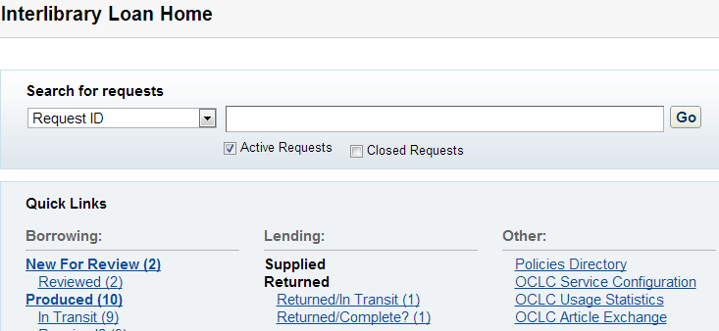
Manage Constant Data in Service Configuration
Constant Data is maintained in Service Config.
Find link to Service Config from ILL Home Screen
Notes:
And one last reminder- If you don’t have Constant Data established for your library, or just want to edit/maintain existing records, you’ll want to go to the Service Config module to set it up.
Find the link for Service Config on the ILL Home Screen, click on it, and a new window or tab will open up in your browser. You will be automatically logged in to Service Config.

Slide 30
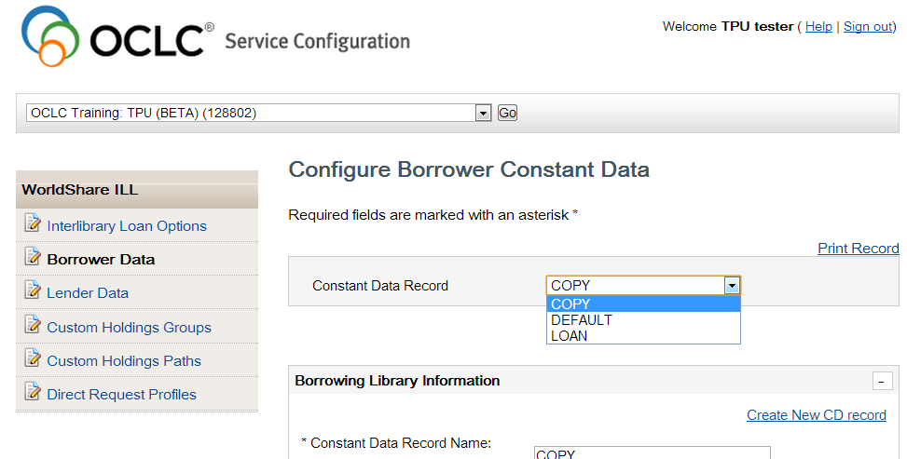
Manage Constant Data in Service Configuration
Notes:
Once inside, click WorldShare ILL from left menu, then click Borrower Data.
Simply fill out form with your address and contact information, as well as preferences for ordering items (IFM, electronic delivery options, etc).
[Share screen in WebEx, and switch over to browser window. Click on Service Config link from ILL Home Screen. Click WorldShare ILL on left, then Borrower Data. Briefly scroll through form to show different sections, and note how these sections correspond to workform that is submitted for requests. When done demonstrating, come back to Presentation slides]

Slide 31
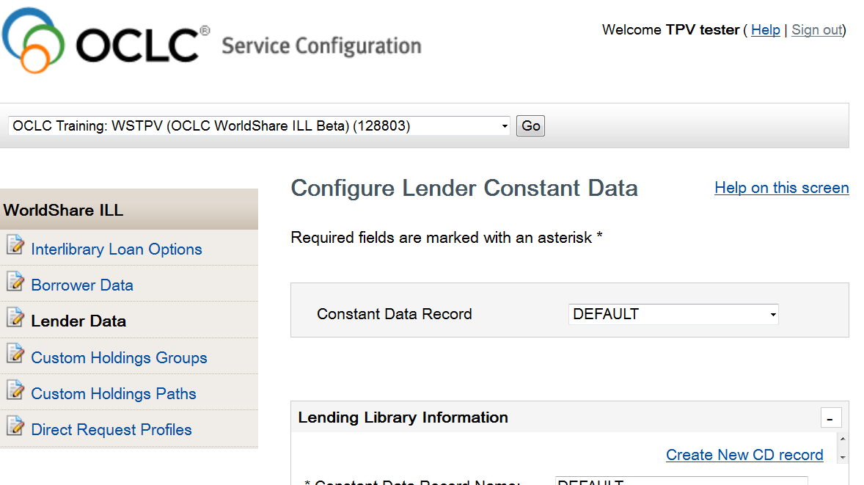
Manage Constant Data in Service Configuration
Notes:
Once inside, click WorldShare ILL from left menu, then click Lender Data.
Simply fill out form with your address and contact information.
[Share screen in WebEx, and switch over to browser window. Click on Service Config link from ILL Home Screen. Click WorldShare ILL on left, then Lender Data. Briefly scroll through form to show different sections, and note how these sections correspond to request form. When done demonstrating, come back to Presentation slides]

Slide 32
Helpful Info- WorldShare ILL & associated modules
The Policies Directory will stay the same:
No major changes
Can access Policies Directory from WorldShare ILL
Make sure your policies are up to date!
ILL Policies Directory-
https://illpolicies.oclc.org/
Notes:
And there are no big changes with the ILL Policies Directory at this time.
You will be able to access the Policies Directory from various links in the WorldShare ILL interface.
If you’re a lender, you’ll want to make sure your own Profile on the ILL Policies Directory is up to date. Remember, the Policies Directory is where potential borrowers will come to get information about borrowing ILL items from you, so you want to make sure you’ve got accurate info for them to see.

Slide 33
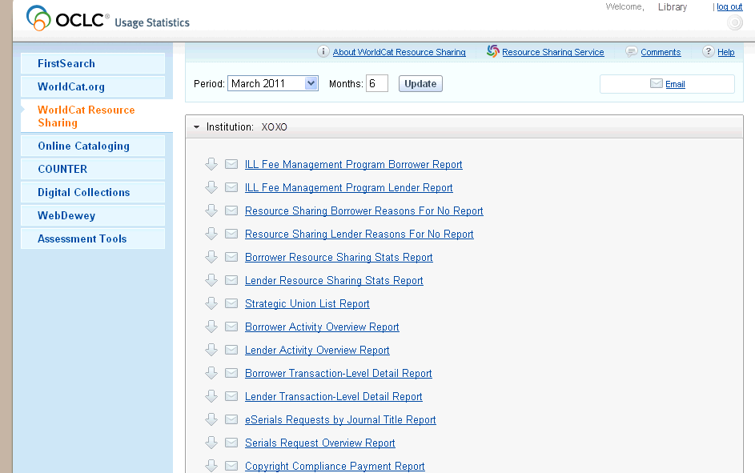
Helpful Info- WorldShare ILL & associated modules
OCLC Statistics Portal: http://www.stats.oclc.org
Notes:
Another module associated with WorldShare ILL is the OCLC Statistics Portal.
The Stats Portal has its own web address- www-dot-stats-dot-oclc-dot-org.
There is also a link to the Stats Portal from the WorldShare ILL home screen…

Slide 34
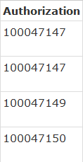
Helpful Info- WorldShare ILL & associated modules
OCLC Statistics Portal: http://www.stats.oclc.org
For now, use your 9-digit Authorization Number and Password from WorldCat Resource Sharing to log in to the Usage Statistics Portal
Notes:
…but, for the time being, you’ll still need your 9-digit Authorization number and Password from the current system, WorldCat Resource Sharing, to log in to the Stats Portal.
So don’t get rid of your current 9-digit Authorization number and Password just yet.

Slide 35
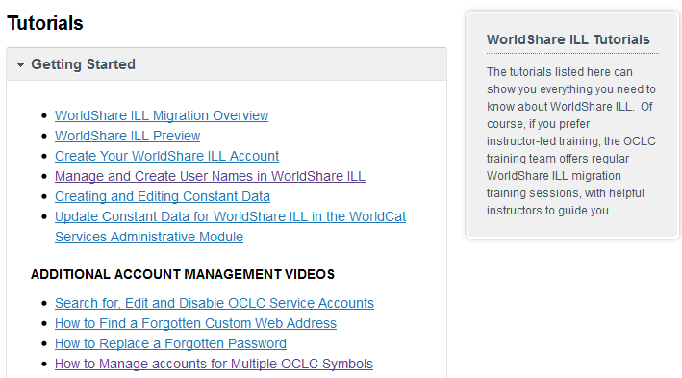
WorldShare® ILL Training
Tutorials for WorldShare® ILL are available at this site:
http://www.oclc.org/support/training/portfolios/resource-sharing/worldshare-ill.en.html
Notes:
There is extensive list of video tutorials and recordings of webinars all on WorldShare ILL at the website listed here.
Let’s do a quick exercise-
I’m going put the link for this website into the chat window now [copy this link and paste it into chat window: http://www.oclc.org/support/worldwide/en_us/training/portfolios/resource-sharing/worldshare-ill.html
I’d like all of you to click on this link, so that it opens up the training page in your browser.
Once you’re looking at the documentation page, I want you to find the link for the tutorial with the title “Create Your New WorldShare ILL Account.” When you simply find the tutorial named “Manage and Create User Names in WorldShare ILL” on that documentation page, come back to the WebEx page, and in the Participants list give me a green check mark to let me know you were able to locate that tutorial on the documentation site.

Slide 36
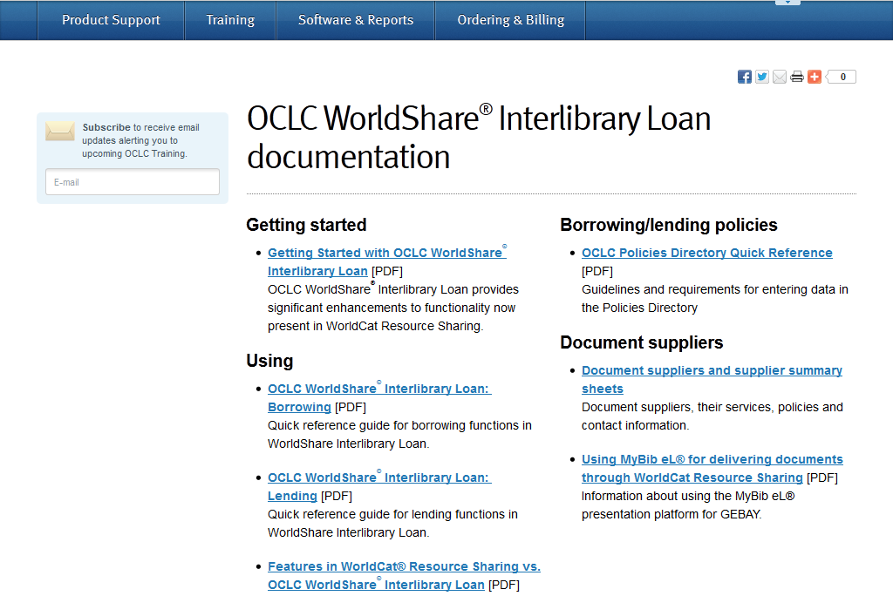
WorldShare® ILL Documentation
Documentation for WorldShare® ILL:
http://www.oclc.org/support/services/worldshare-ill/documentation.en.html
Notes:
Review the documentation site for resources related to WSILL.

Slide 37
Training Overview and Demonstration

Slide 38
Borrower & Lender Training Sessions:
Borrower - We will be submitting requests on behalf of patrons:
  Staff Initiated, Staff-Mediated requests from the WorldShare® ILL interface
Lender - We will be responding to requests:
  Staff-Mediated requests processed directly from the WorldShare® ILL interface
Notes:
Ok, let’s get ready to do some exercises with WorldShare ILL.
For our exercises, the scenario we will be working from is we will be submitting requests on behalf of our patrons. So these will be staff initiated, staff mediated requests in the WorldShare ILL interface.
[CLICK TO NEXT SLIDE]

Slide 39
Borrower Request Workflow and Exercises
Borrower workflow- Copy and Loan Requests:
  Search for Item
  Select appropriate bibliographic record
  View Holdings Display
  Display potential lender’s policies
  Select potential lenders for lender string
  Apply Constant Data
  Complete request form
  Submit request
Notes:
Here are the steps of the Borrowing Workflow. They are nearly identical for both a copy request and a loan request.
Steps are demonstrated in the Borrowing class.

Slide 40
Managing Requests as a Borrower
Outline of managing requests workflow
  Receive with batch
  Return with batch
  Request Renewal
  Respond to conditional
  Unfilled items
  Print Requests
Notes:
Once we have requests in the system, we’ll need to manage them. This list contains the most commonly used actions when managing requests in WorldShare ILL as a Borrower.
This is demonstrated in the Borrowing class.

Slide 41
Managing Requests as a Lender- Demo & Exercises
Lender request management:
  Printing entire queue, Can You Supply?
  Responding Yes to loans, using batch
  Responding Yes to copies
  Responding No, using batch
  Responding conditional
  Respond to Renewals
  Checking in items
  Printing items
Notes:
Once we have requests in the system, we’ll need to manage them. This list contains the most commonly used actions when managing requests in WorldShare ILL as a Lender.
In the Lending class we demonstrate how to do each one of these actions

Slide 42
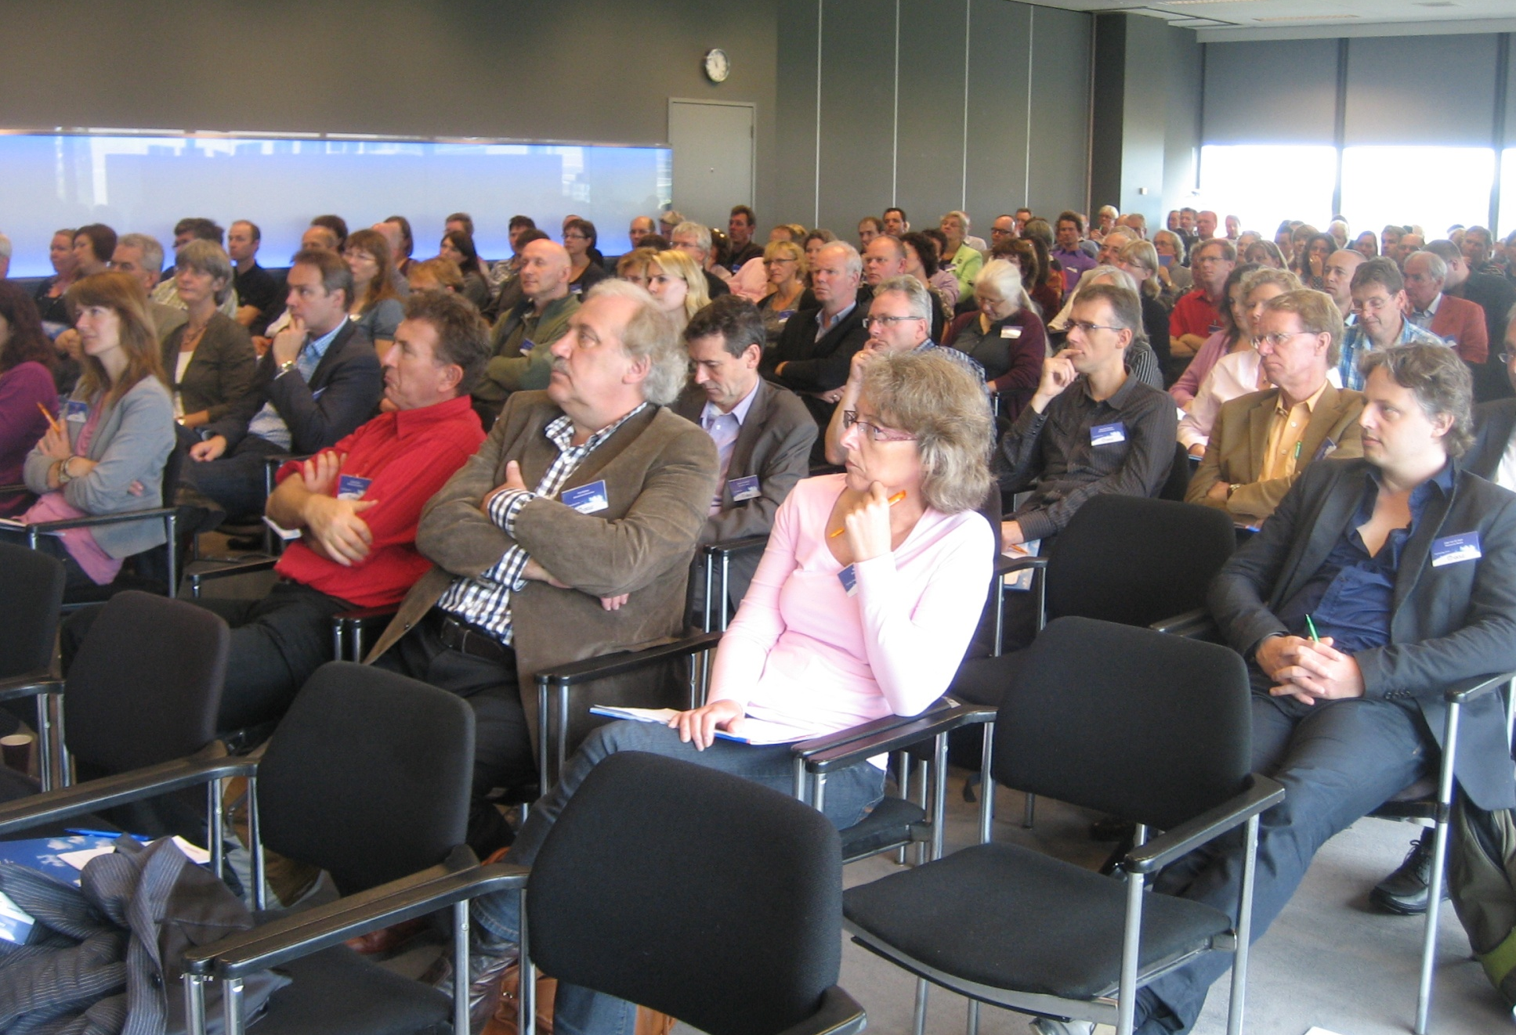
Any Final Questions?

Slide 43
Thank You!
Class name: An Introduction to WorldShare® ILL
Instructor: Michael Cosentino
For help contact OCLC Customer Support:
support@oclc.org / 1-800-848-5800
For training questions contact OCLC Training:
training@oclc.org/

